Slide 1
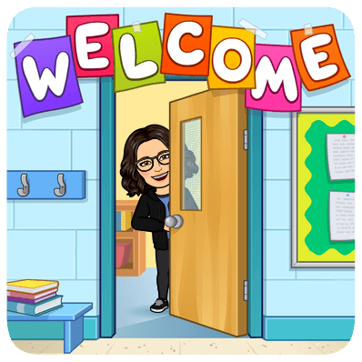

Pleasant Gardens
Elementary School
Title 1 Annual Meeting
2021-2022

Slide 2

Mission: Pleasant Gardens Elementary provides the instructional building blocks for developing lifelong learners. Our engaging learning environment promotes critical thinking, problem solving, and an innovative mindset where students work collaboratively to improve the world around them. We encourage future focused student leaders that appreciate and celebrate the diversity of our school community.
Vision: Pleasant Gardens Elementary School:
The School That Engages Minds

Slide 3

What is Title 1?
Title 1 is the largest federal education program. Its intent is to help ensure that all children have the opportunity to obtain a high-quality education and reach proficiency on challenging state academic content and performance standards.

Slide 4

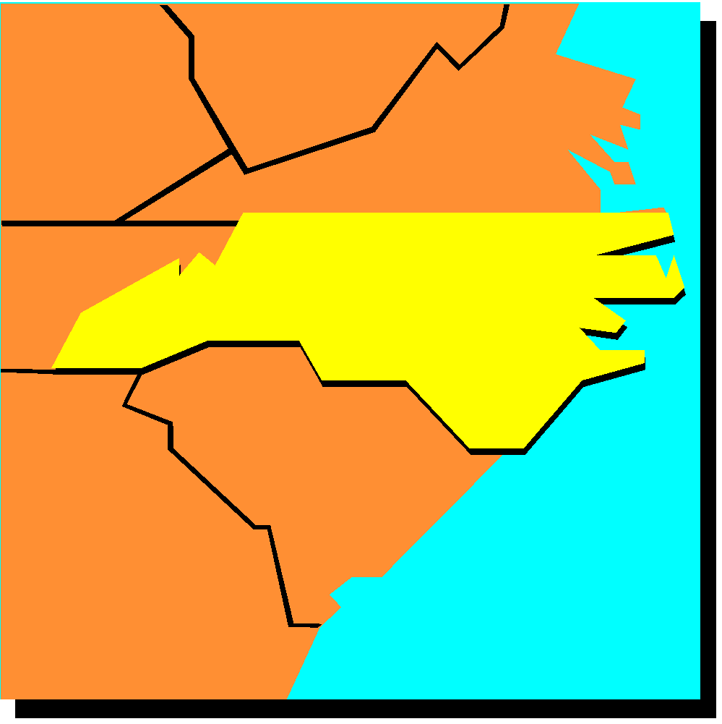
How Does Title I Work?
The Federal government allocates money to the states.
North Carolina’s State Title I plan describes:
    Standards for children’s learning.
    Measurement of Student Performance

Slide 5
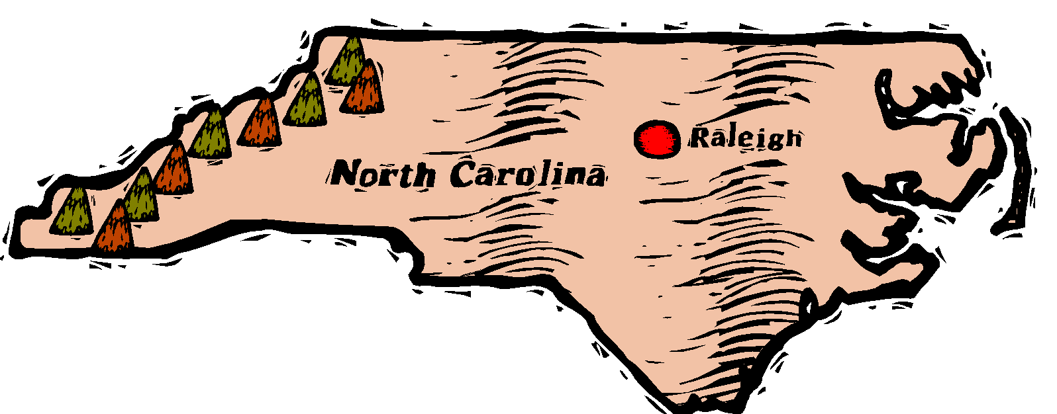
How Does Title I Work?
North Carolina allocates money to school districts.
How?
Based on the number of low income students in each district.

Slide 6

How Does Title 1 Work?
McDowell County Schools allocates money to each qualifying school.
How?
Based upon the number of identified low income students in each school.

Slide 7
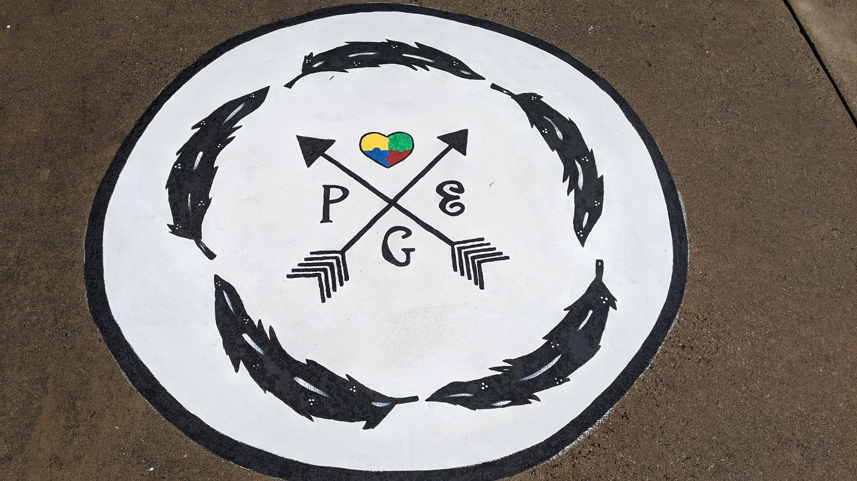
How Does Title I Work?
The following schools qualify for schoolwide Title 1 funding:
Eastfield Global Magnet School
Glenwood Elementary School
Marion Elementary School
Nebo Elementary School
North Cove Elementary School
Old Fort Elementary School
Pleasant Gardens Elementary School
West Marion Elementary

Slide 8

How Does Title I Work?
All schools write a SIP (School Improvement Plan) for increased academic growth and proficiency for all students.
Title I resources and requirements are included in the SIP.
SIPs are continuously revised based on data and the needs of the schools.
SIPs can be accessed on each school’s School Improvement Plan
webpage. Visit www.indistar.org
Username: GuestS16711
Password: GuestS16711

Slide 9

Title 1 at Pleasant Gardens
Elementary School
Our funds are used for the following:
- Parent and Family Engagement Events
- Teacher and Assistant Positions
- Supplementary Reading/Math Programs and Supplies
- Staff Development

Slide 10
Parent and Family Engagement
Schools are also required to plan how they will engage parents and families in the education of their children. Each school must write, with the help of parents, a school Parent and Family Engagement Policy.

Slide 11
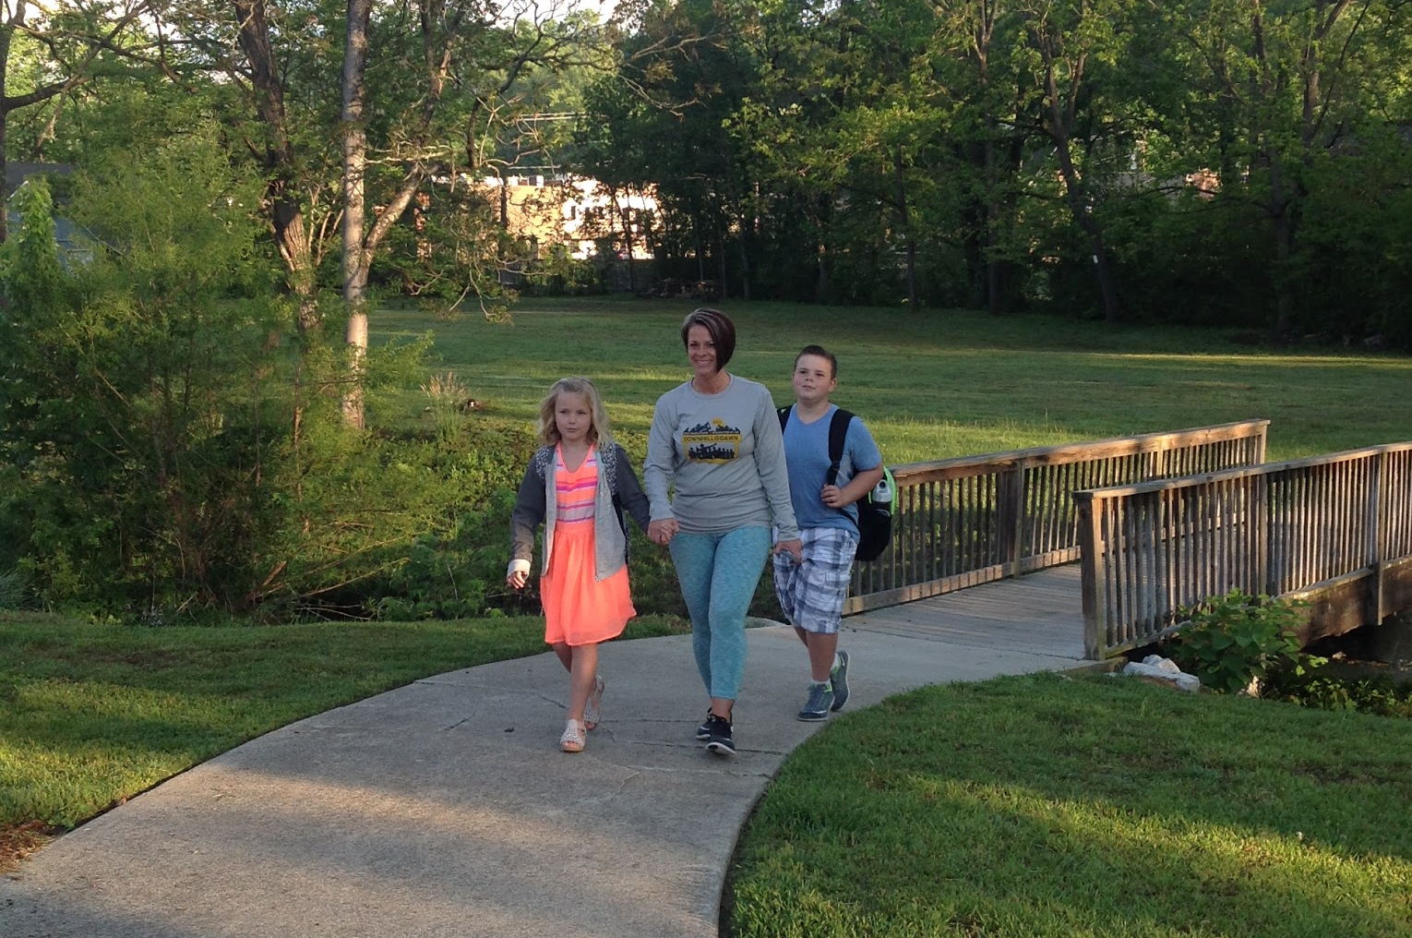
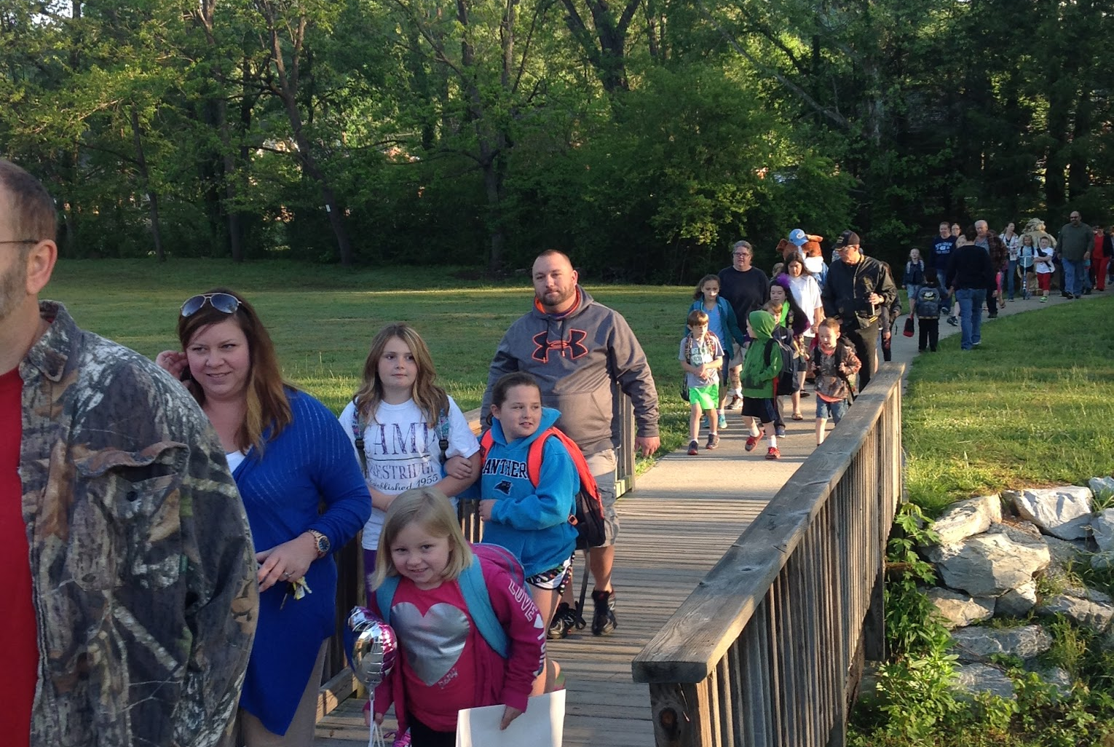
Parent and Family Engagement
The school’s Parent and Family Engagement Policy describes how schools and families work together to help children succeed.
Accountability agreements (compacts) state the responsibilities for learning for parents, students, and school staff.
Title I money can also be used to:
Translate school information into families’ first language.
Host activities to help families help children learn.
Offer parenting classes for parents.

Slide 12
How Can You Help Your Child?
Families are an Important Part of our Title 1 School!
Be sure your child comes to school ready to learn. Ensure your child:
  Is well rested.
  Eats breakfast (breakfast is served daily at no cost to students).
  Completes homework and reads nightly.
  Views remote lessons as much as possible.
  Asks for help when needed.

Slide 13
How Can You Help Your Child?
Families are an Important Part of our Title 1 School!
View your school’s Annual Title I meeting to learn more about Title I and your rights and responsibilities as a parent.
Work with other families and teachers to revise your school plan (SIP) and parent involvement plan.
Attend your children’s school conferences and family activities designed to help your children succeed.
Your Superintendent Advisory Representative has been Heather Murdock.

Slide 14

Parent’s Rights To Know
Whether the teacher has met state qualifying and licensing criteria for the grade levels and subject areas in which the teacher is teaching;
Whether the teacher is teaching under emergency or another provisional status through which state qualification or licensing criteria have been waived;
The teacher’s college degree major and any other graduate certification or degree held by the teacher, including the field of discipline of the certification or degree; and
Whether the child is provided services by a teacher assistant and if so, the assistant’s qualifications.
In addition, if a child is assigned, or taught by, a teacher who is not licensed in the core academic area for which he/she is assigned for four or more consecutive weeks, the parent must receive timely notice.

Slide 15
Parent and Family Engagement Plan
Orientations Parent Link
Virtual Meetings Annual Meeting
Parent Conferences (three times a year) Accountability Agreements
PTO Meetings
Parent and Family Engagement Events This year, meetings and events will
Classroom Dojo/Google Classroom take place under Covid19 guidelines.

Slide 16
Let us know what you think!
Now that you have viewed these slides, please take just a moment to complete a family input survey at:
Family Survey
The survey is accessible from our school website and will be shared in Class Dojo and Google Classroom.

Slide 17
For More Information...
Please contact:
Melissa Elliott - Principal, Pleasant Gardens Elementary
Iris Lawing, Title 1 Coordinator at Pleasant Gardens Elementary
Or
Crystal Hamby, Director of Elementary Education and Federal Programs at
828-652-4535 Ext. 104

